Slide 1

BANK MANAGEMENT SYSTEM IN C++
Made By :
Kiran Kumar Malik
B.Tech CSE
(20030112018)
Mayank Gopal
B.Tech CSE
(200301120176)
Guided By-
Prof. Shivani Nanda
Semester: 2nd Sem
Section: C

Slide 2
CONTENT
1
Introduction
Working description
Features
Requirements
Project Objectives
Concepts used
Source code and Outputs
Conclusion
2
3
4
5
6
7
8

Slide 3
INTRODUCTION
This project Bank Management System includes some facilities of customer's and search account holder list, display, modification, delete etc. This software searches the customer’s data which is store in the record and then gives permission to access the bank facilities by the customer. The software used for small scale Banks which have limited customers and facilities and wants to maintain the records.

Slide 4
WORKING DESCRIPTION
This program consists of the following features:-
1) Open new account
2) Deposit
3) Withdraw Amount
4) Balance Enquiry
5) All Account Holder List
6) Close An Account
7) Modify An Account
8) Exit

Slide 5
FEATURES
This project is a program to store data of customers and their details as well as transactions.
The manager can add the customer and update the customer’s details.
Similarly, the customers manages the deposit and withdrawal.
Developed using C++ language.
Easy to operate and understandable.

Slide 6
REQUIREMENTS
A Computer with-
Operating system: Windows, MacOS or Linux
Processor: Pentium3, 32-bit
RAM: 1.00 GB
System type: 32-bit operating system, x32-based processor
Dev-C++
Microsoft office word
Microsoft office Powerpoint

Slide 7
PROJECT OBJECTIVE
Bank management system will able to provide quick services to their customers by using their records which has been saved previously. However new records can be added any time whenever any customers visited to their Bank. To identify the customers each customers will be provided with their account number and during data entering process all their basic information’s will be added into the file in the binary format.
Each customer will be provided with Bank passbook and each bank passbook will have a account number by which system will easily able to identify their customers and prepare their transaction list for the services which they have deposited and withdrew.

Slide 8
CONCEPTS USED
Header file
Class
Member function
Function declaration
Function to write in file
Function to read specific record from file
Function to modify record of file
Function to delete record of file
Function to display all record
Type casting operator
While loop
If else statements
Switch case

Slide 9
SOURCE CODE

Slide 10
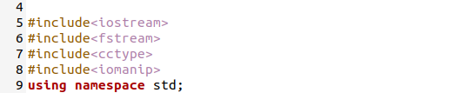
HEADER FILE USED

Slide 11
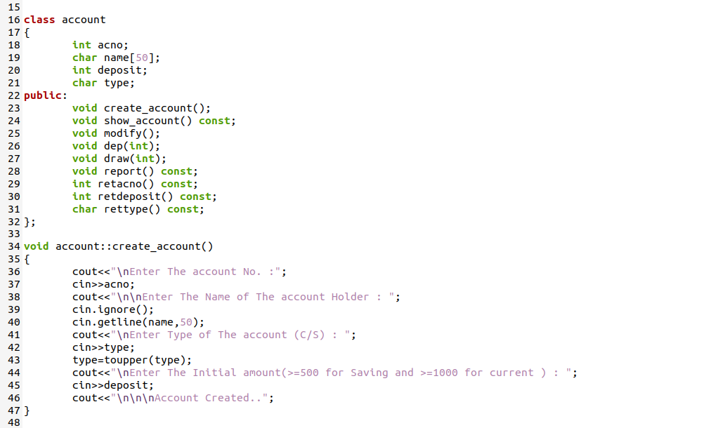
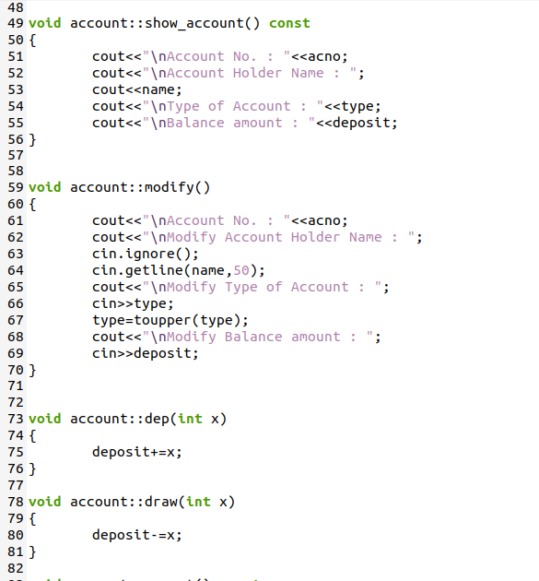
Class used

Slide 12
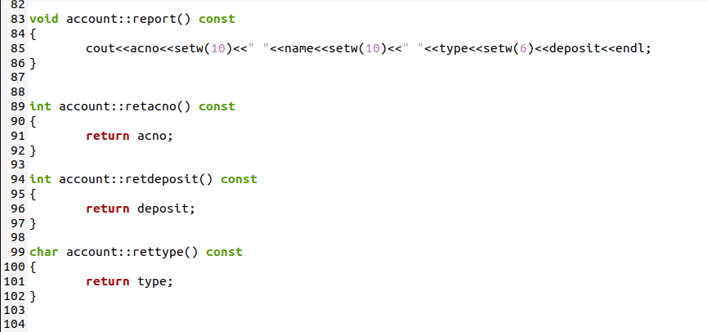

Slide 13
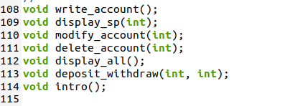
Function Declaration

Slide 14
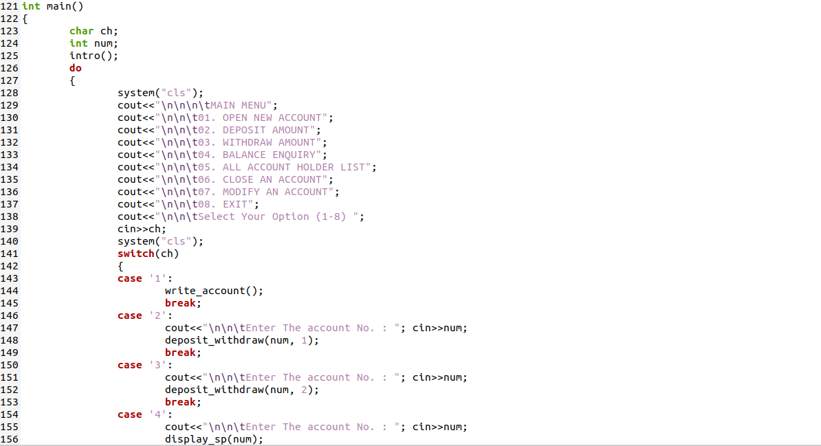
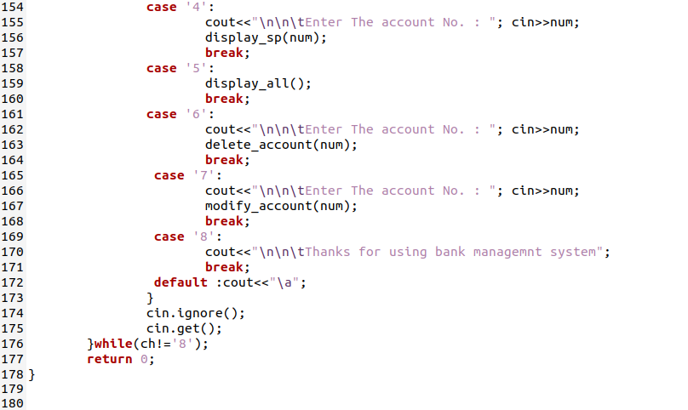
Main Function of Program

Slide 15
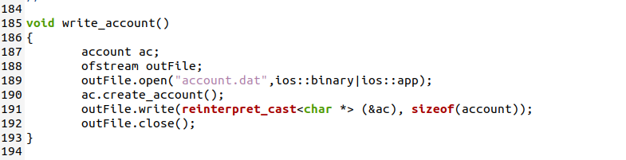
Function to write in file

Slide 16
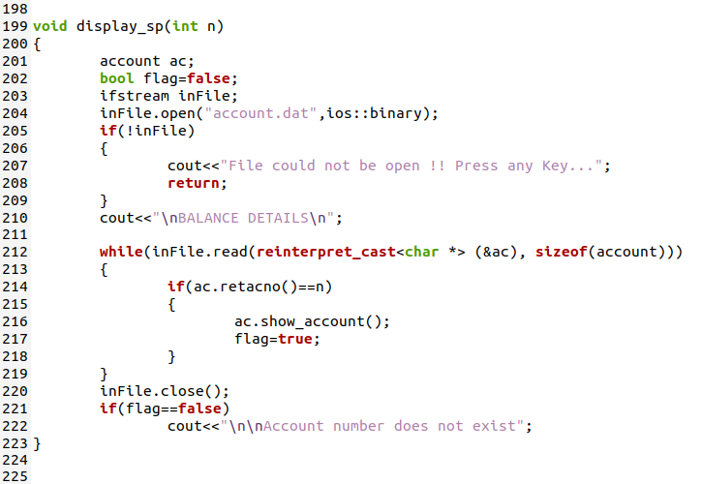
Function to read a specific record from file

Slide 17
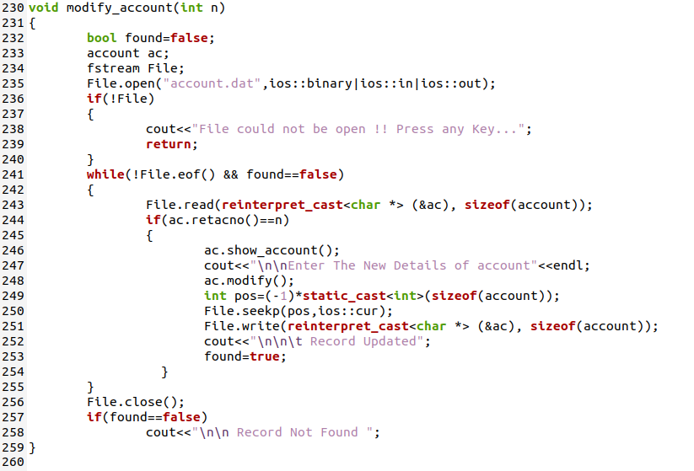
Function to modify record of file:

Slide 18
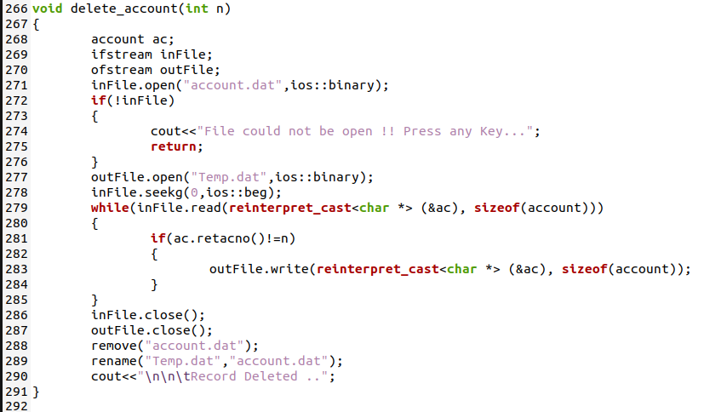
Function to delete record

Slide 19
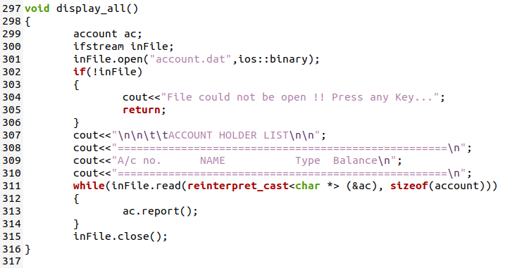
Function to display all accounts deposit list

Slide 20
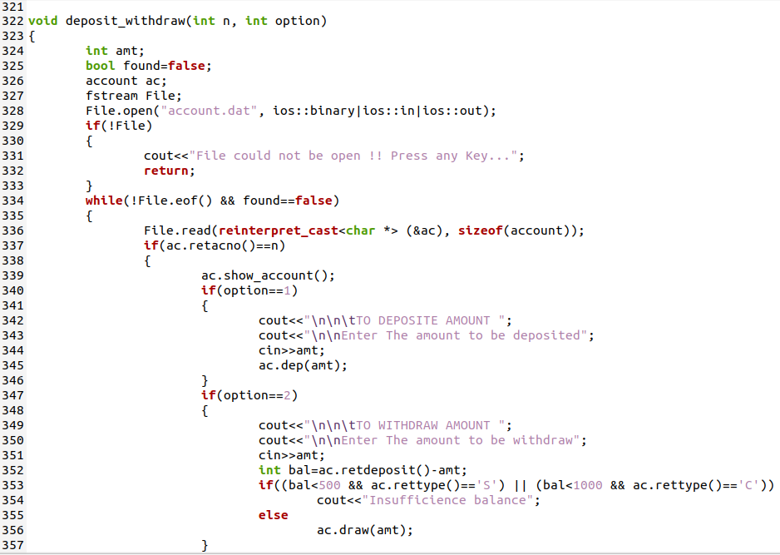
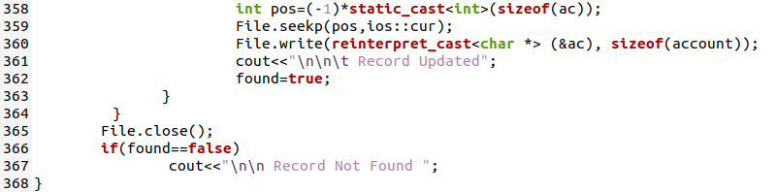
Function to deposit and withdraw amounts:

Slide 21
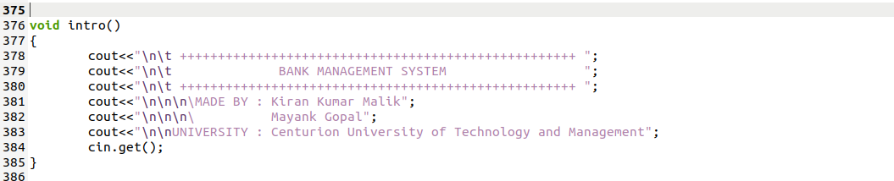
Introduction Function:

Slide 22
OUTPUT

Slide 23
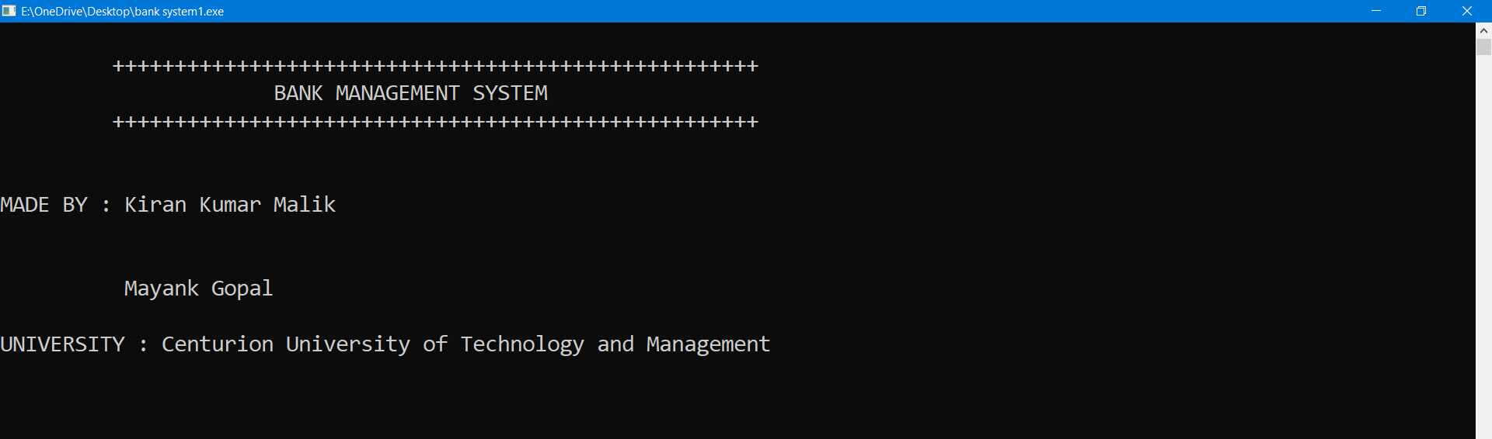
INTRO

Slide 24
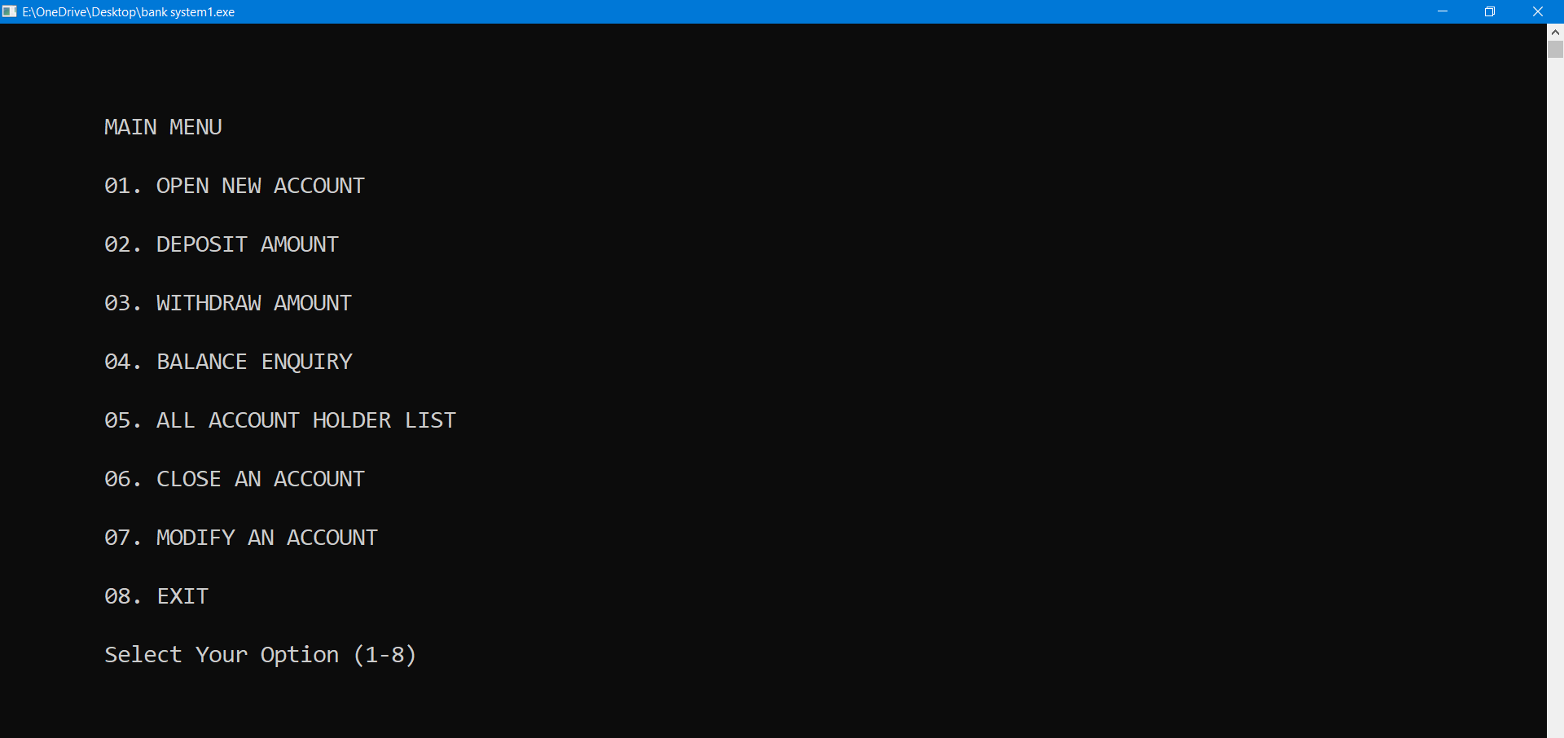
Main Menu

Slide 25
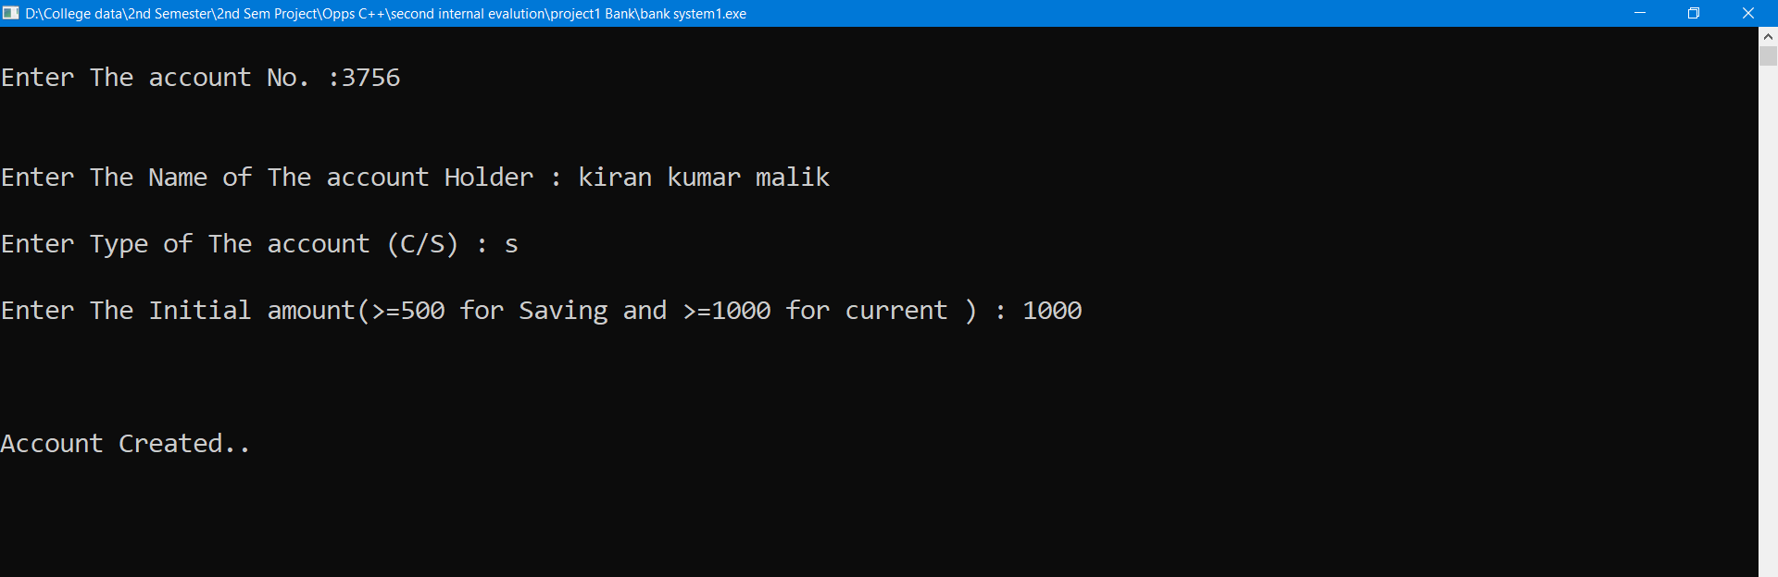
Open Account

Slide 26
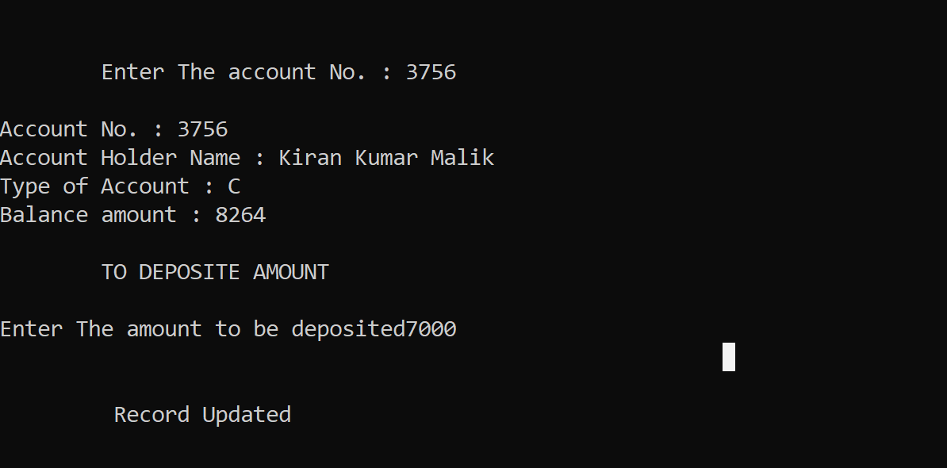
Deposit Amount

Slide 27
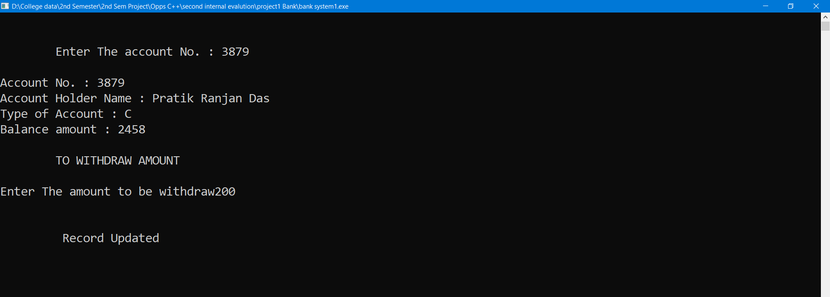
Withdrawal Amount

Slide 28
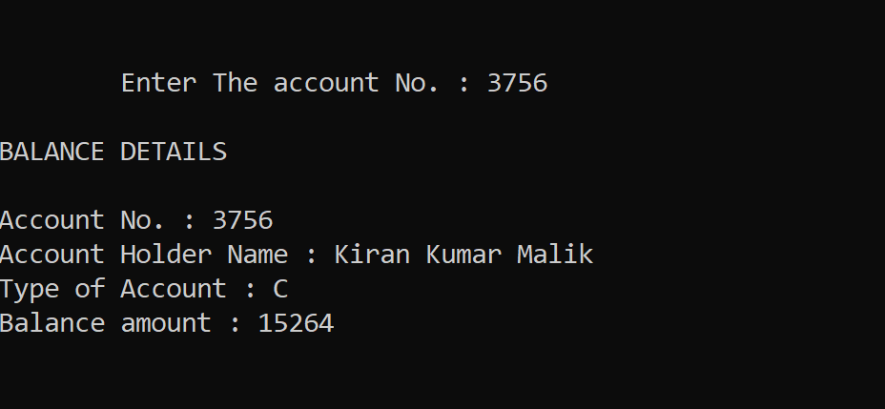
Balance Enquiry

Slide 29
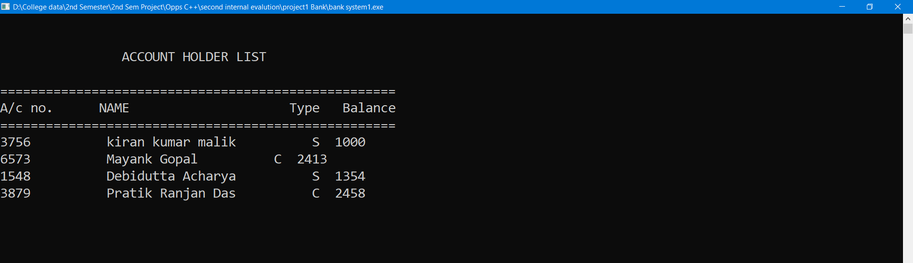
Account holders list

Slide 30
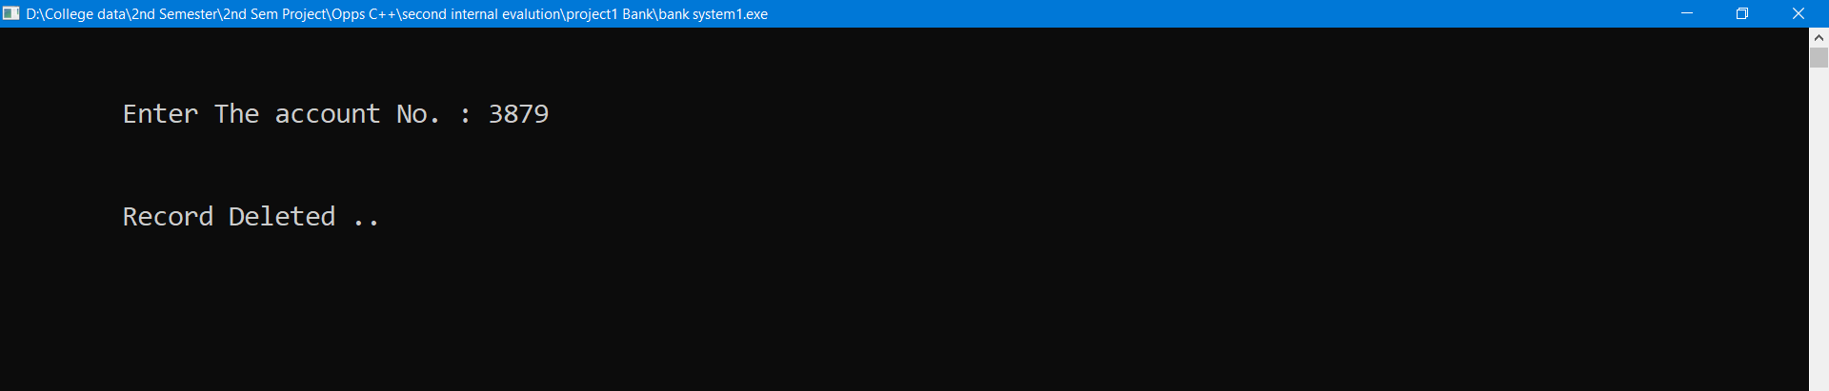
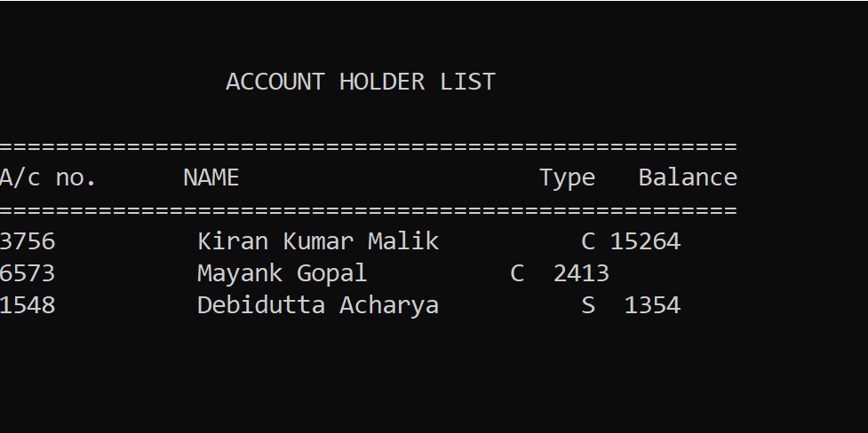
Closing an Account

Slide 31
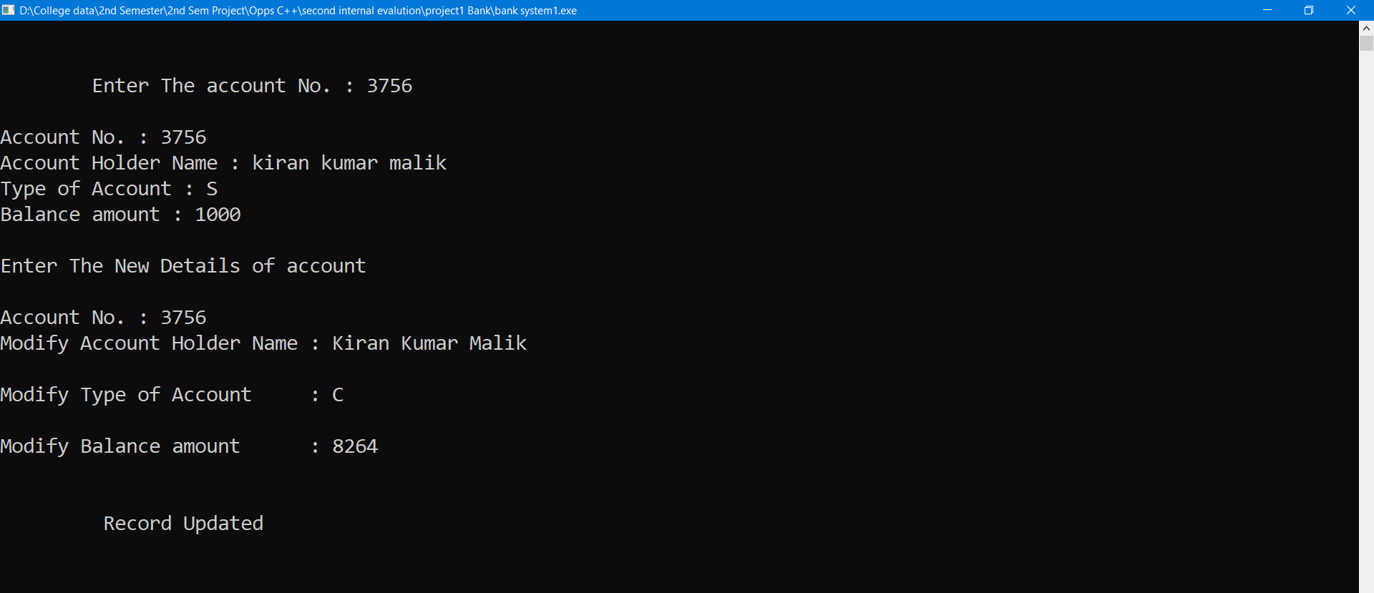
Modify an Account

Slide 32
CONCLUSION
This software is efficient in maintaining customer’s details and can easily perform operations on customer’s records and also works to handles the information of the facilities available in a bank. This software also reduces the work load of the banks. In future, this system can launch web site for easy online bank facilities

Slide 33

Thank You

